Slide 1
Environmental & Climate Data Analysis
Presented By:
Sarthak Goswami, Priyansh Gangwar, Krishna Garg

Slide 2
Project Overview
This project explores climate trends using a sample
Global Surface Summary of the Year (GSOY) dataset.
We analyze average temperature and precipitation
patterns across multiple years.
Key steps:
- Data Cleaning & Preprocessing
- Handling Missing Values
- Feature Normalization
- Visual Analysis & Interpretation

Slide 3

Dataset Information
Source: GSOY Sample Dataset
Total Records: 41 years
Key Features:
- DATE (Yearly)
- TAVG (Average Temperature)
- TMAX (Max Temp)
- TMIN (Min Temp)
- PRCP (Precipitation)
Cleaned and transformed columns
for analysis

Slide 4
Data Cleaning and Preparation
Converted DATE to datetime format and
extracted YEAR
Filled missing values in:
- TAVG using mean imputation
- PRCP using forward-fill method
Normalized:
- TAVG and PRCP using Min-Max Scaling

Slide 5
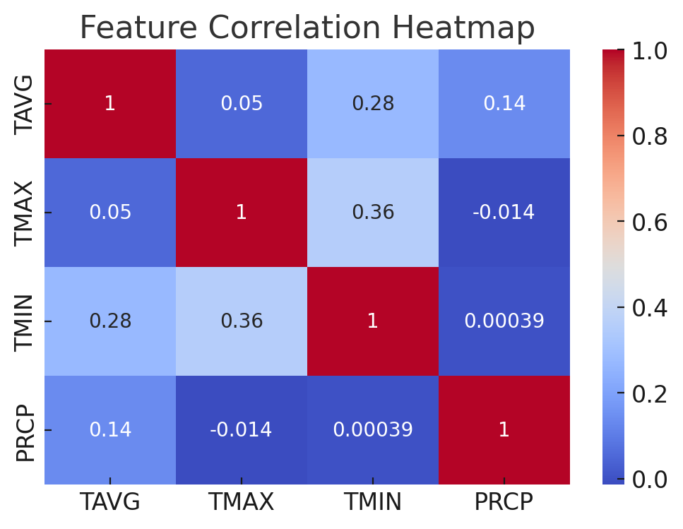
Correlation Heatmap
Observations:
Strong correlation
observed between
TAVG, TMAX, and
TMIN
PRCP shows less
correlation with
temperature features

Slide 6
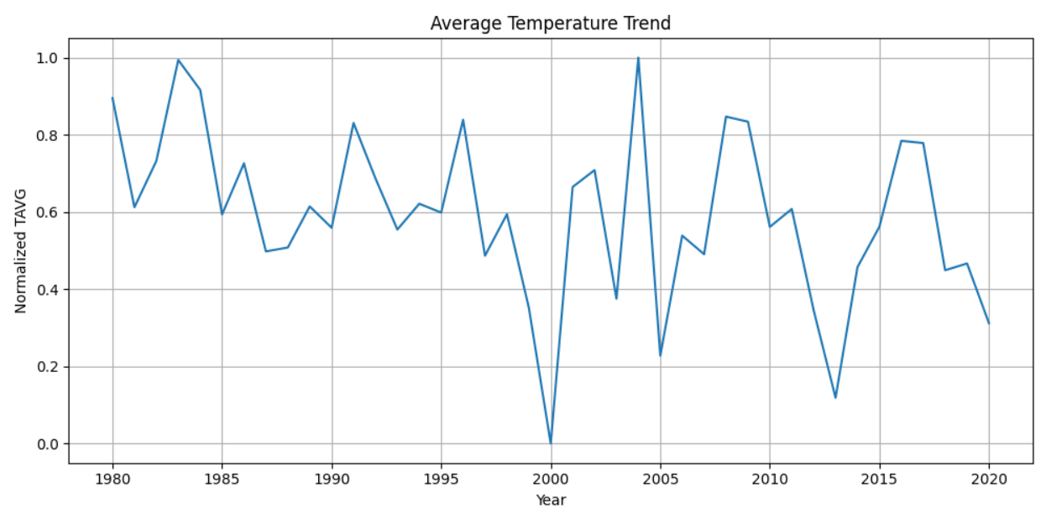
Normalized Average Temperature Over Years
Observations:
Gradual increase in normalized average temperatures
Reflects possible climate warming patterns

Slide 7
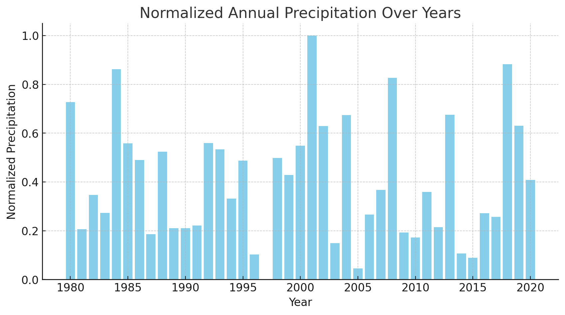
Normalized Annual Precipitation Over Years
Observations:
Precipitation levels show fluctuations over the years
No clear increasing or decreasing trend

Slide 8
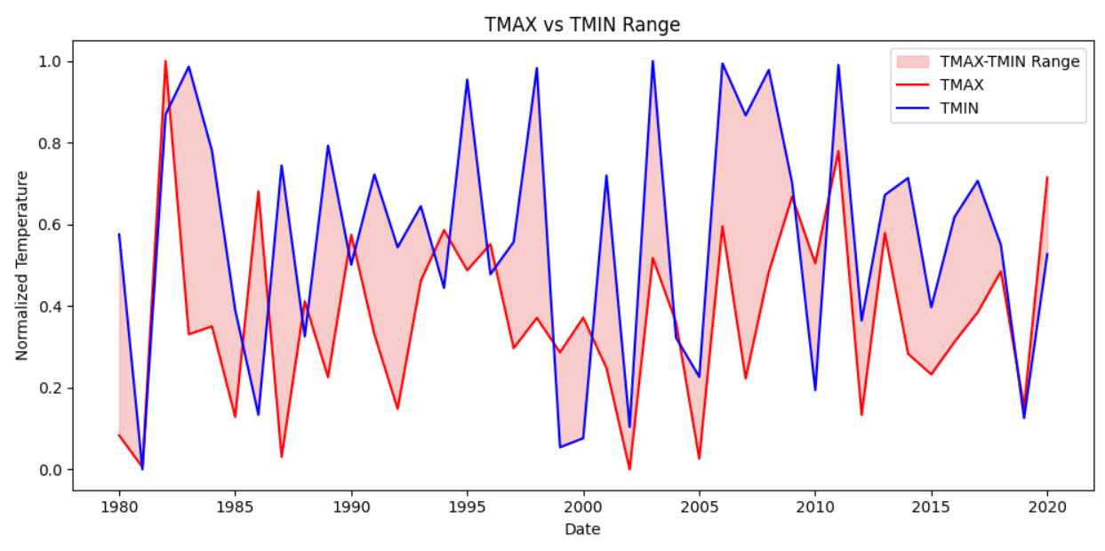
TMAX vs TMIN Range
Observations:
Area chart filling between TMAX and TMIN
Highlights seasonal temperature range fluctuations

Slide 9
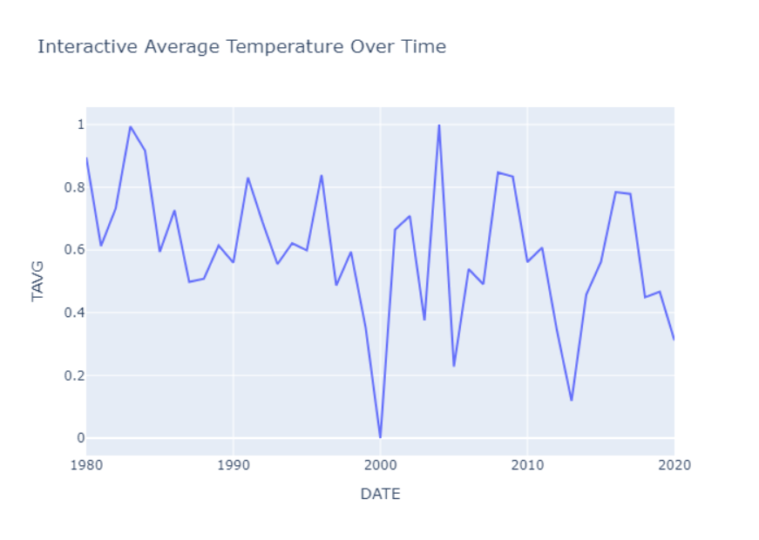
Interactive Average Temperature Trend
A dynamic line chart showing the normalized average temperature (TAVG) for each year.
Quickly identify years with unusually high or low temperatures.
Visually explore short-term fluctuations versus long-term trends.

Slide 10
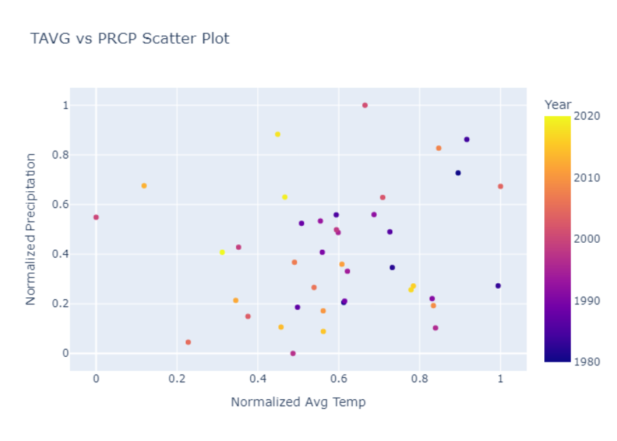
TAVG vs PRCP Scatter Plot
A scatter plot showing the relationship between normalized average temperature (TAVG) and normalized precipitation (PRCP) for each year.
Observe whether hotter years tend to coincide with wetter or drier conditions.
Spot any outliers (e.g., very high rainfall paired with average temperatures).

Slide 11
Summary Statistics
 | Metric | TAVG | TMAX | TMIN | PRCP
 | Count | 41.0 | 41.0 | 41.0 | 41.0
 | Mean | 0.50 | 0.50 | 0.50 | 0.50
 | Std Dev | 0.31 | 0.29 | 0.31 | 0.30
 | Min | 0.00 | 0.00 | 0.00 | 0.00
 | Max | 1.00 | 1.00 | 1.00 | 1.00

Slide 12

Conclusion
Findings:
Evidence of gradual warming (TAVG)
Precipitation levels fluctuate year-to-year
Next Steps:
Regional analysis by station/continent
Forecasting future trends (time-series models)
Integrate CO₂ and other environmental variables

Slide 13
Thank you

